Slide 1

Session 2: BreadBoarding
Tommy Morris
Professor, Electrical and Computer Engineering
Director, Center for Cybersecurity Research and Education
University of Alabama in Huntsville

Slide 2
Arduino
Arduino is a family of single board computers.
Arduino is an opensource hardware and software company.
Many companies manufacture Arduino boards.
Not all are created equal.
At UAH, we have had good experience with Elegoo.
The board and kit used for this class is the ELEGOO UNO Project Basic Starter Kit with Tutorial and UNO R3 for Arduino
Available on Amazon.com for $16.99 (May 29, 2019)
https://www.amazon.com/Elegoo-EL-KIT-004-Project-Starter-Tutorial/dp/B01DGD2GAO

Slide 3
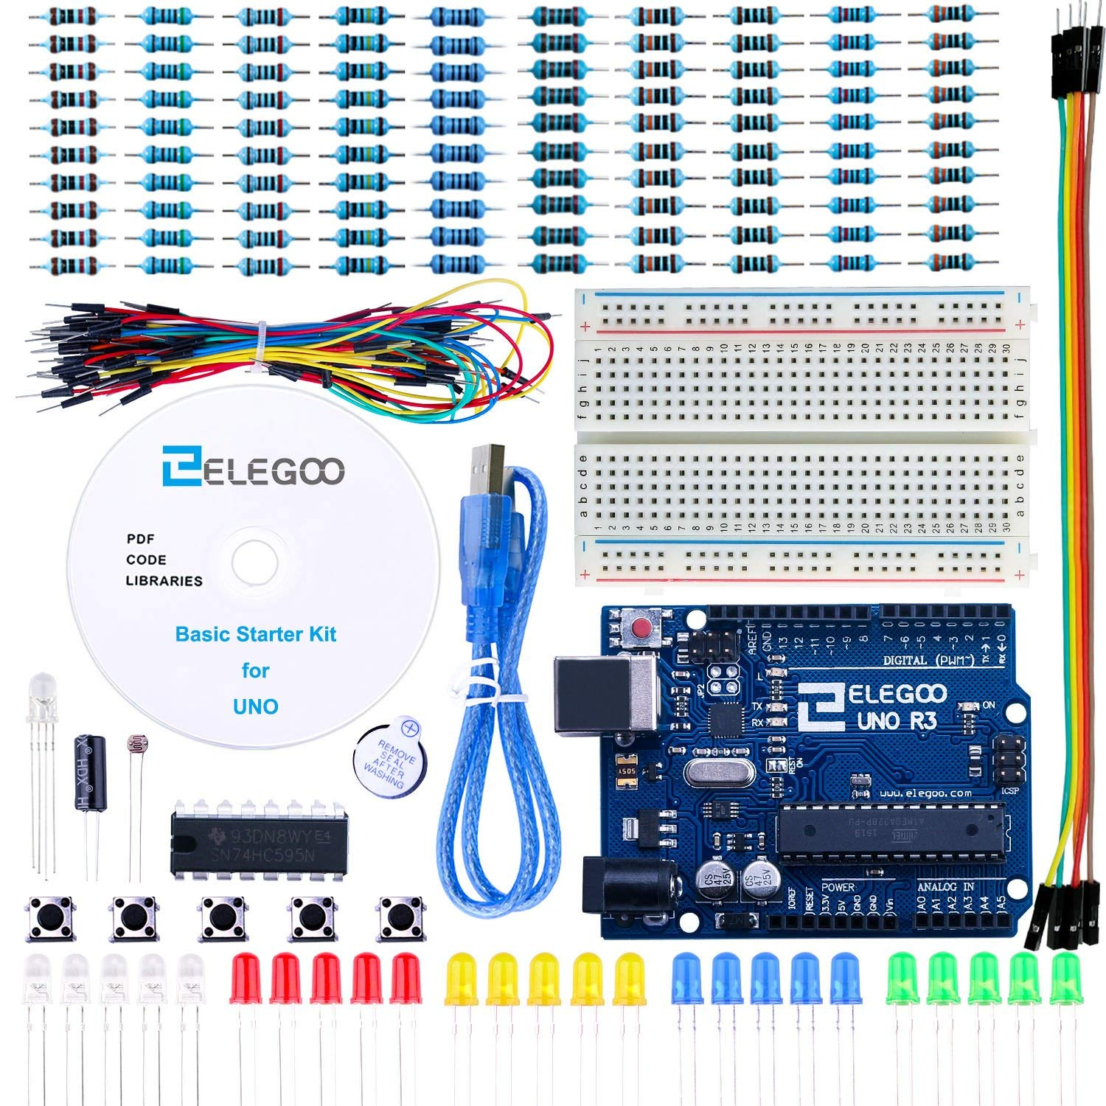
ELEGOO UNO Project Basic Starter Kit with Tutorial and UNO R3 for Arduino
Arduino Uno
USB Cable
Breadboard
5 buttons
25 LED
120 resistors (various sizes)
65 male to male jumper wires
5 male to male to female wires
2 photo resistors
1 tilt switch
1 74HC795 (8-bit shift register)
Buzzer
Tutorial CD

Slide 4
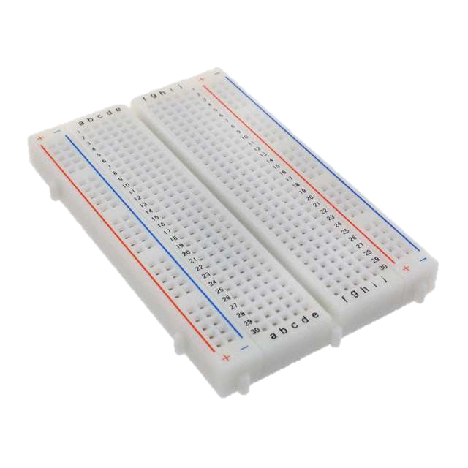
BreadBOARD Connectivity
short circuit examples
Rows are labeled 1,2,3,…,30
Columns - labeled a,b,c,…,j
All pinholes on the same row in columns a-e are short circuited to one another
All pinholes on the same row in columns f-j are short circuited to one another
+ and - rails are available on the left and right sides of the board.
For each side (left and right) all rows of the + column are short circuited to one another
For each side (left and right) all rows of the - column are short circuited to one another
The left and right sides are not connected to each other

Slide 5
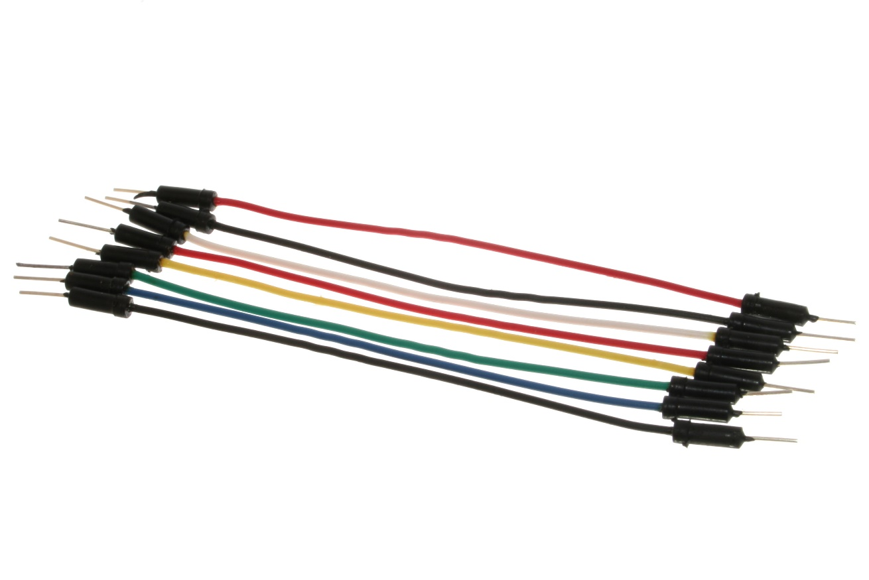
Wires
Wires are short circuits.
Wires have 0 ohms resistance.
We use wires to connect Arduino pins to the breadboard and to connect breadboard cells to one another.
The wires in the kits are also known as Dupont wires.
There are two types in the kits male-to-male and male-to-female.

Slide 6
Power and Ground
Power is the positive voltage.
Generally, power uses a black wire.
The Arduino Uno has 2 power rails
3.3V
5V
Ground (aka. gnd and common) is the negative voltage.
Connect the 3.3V pin on the Arduino to the + rail on the bread board.
Connect the GND pin on the Arduino to the - rail on the bread board.
Note: There to GND pins. Use either one. They are short circuited together on the Printed Circuit Board (PCB).
Use Dupont wires to connect the left and right + rails to one another. Repeat for the two - rails.

Slide 7
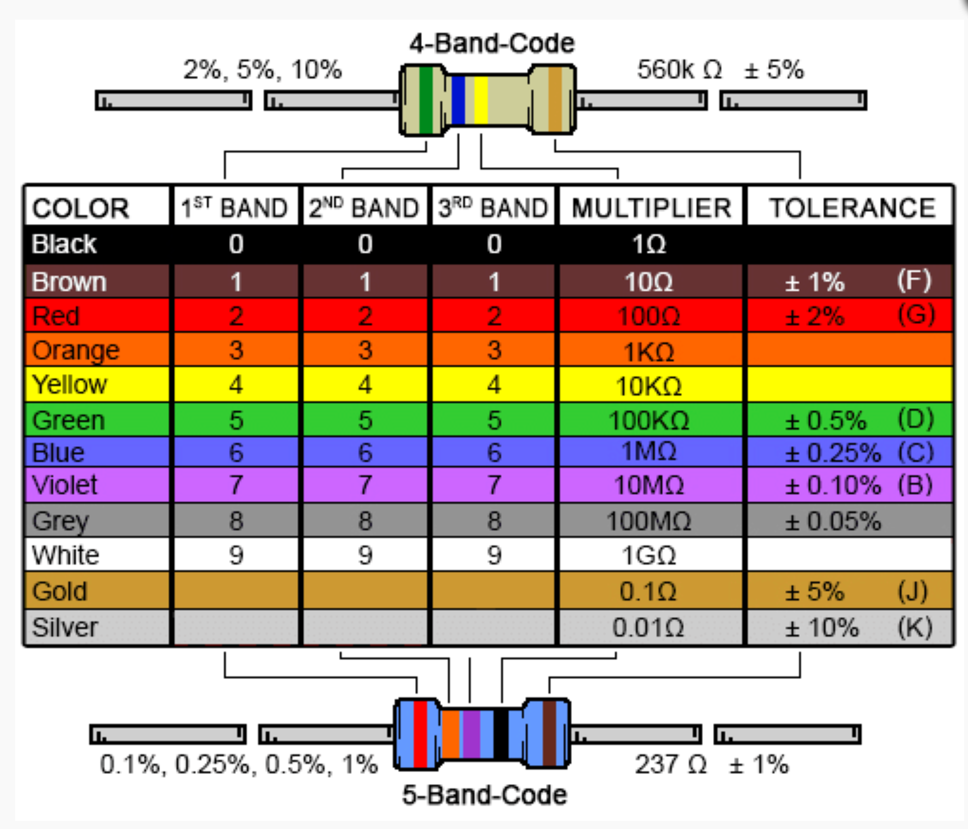
Sizing Resistors
The resistors in the Elegoo kit have 5 color bands.
Use the table to calculate resistance values.
Use the calculator here https://www.digikey.com/en/resources/conversion-calculators/conversion-calculator-resistor-color-code-4-band
Use the label on the tape holding the resistors
Use a multimeter to measure the resistance.
Use an app
or
or
or
or

Slide 8
What is a Resistor?
Resistors limit current. They limit the number of electrons that can pass through a medium.
Resistors are measured in units of Ohms.
Ohms law states:
V = RI : Voltage (V) = Resistance (R) * Current (I)
For a given (constant) voltage, as resistance increases current decreases.
Resistance is also known as impedance.
For DC (Direct Current) circuits resistance and impedance are the same.
Resistance is abbreviated R and impedance Z.
Arduino has 2 voltages: 3.3V and 5V. These don’t change.

Slide 9
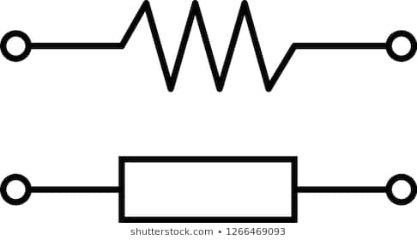
Resistor Symbols
Sometimes resistors are labeled R1, R2, ... (or Z1, Z2, …)
Sometimes resistors are labeled with values.

Slide 10
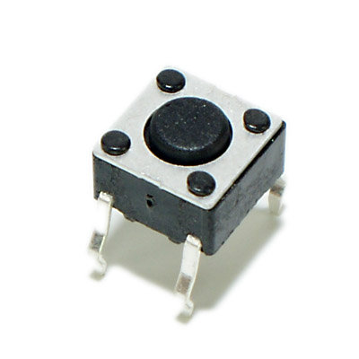
Buttons
Push button switches
Buttons are normally open circuits.
This means there is infinite resistance across the terminals
The terminals are electrically isolated from one another
When pressed the circuit is closed
This means the there is 0 resistance across the terminals
The terminals are electrically short circuited to another
when open (not pressed)
when closed (pressed)

Slide 11
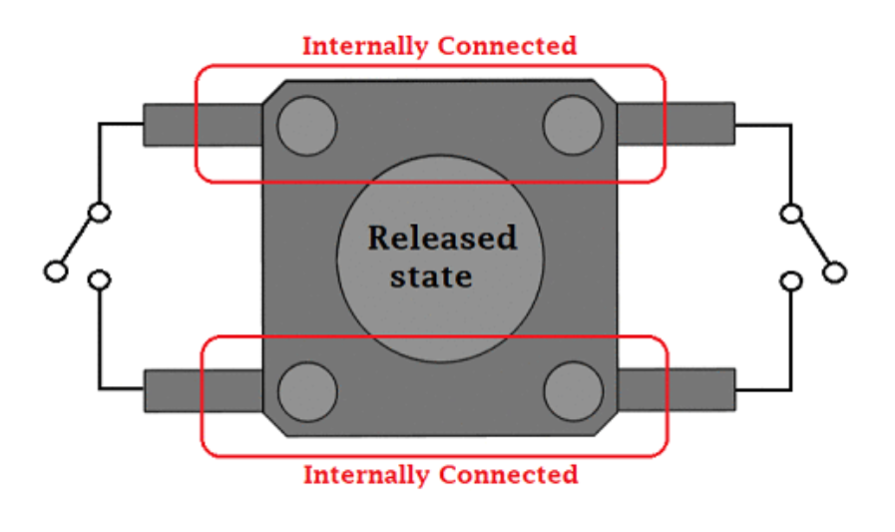
Buttons

Slide 12
Resistor USE CASES
Advanced: Output pins can also use pull-ups/downs when the pin is tri-stated.
Pull-ups and pull-downs
These are large resistors connected between input pins and a power rail.
Pull-downs connect the pin to GND.
Pull-ups connect the pin to the positive voltage rail.
Use when the input pin is not normally connected to a power rail or driven in some way. This ensures the input pin is not.
Some chips have internal pull-ups/pull-downs. Arduino I/O pins do not.

Slide 13
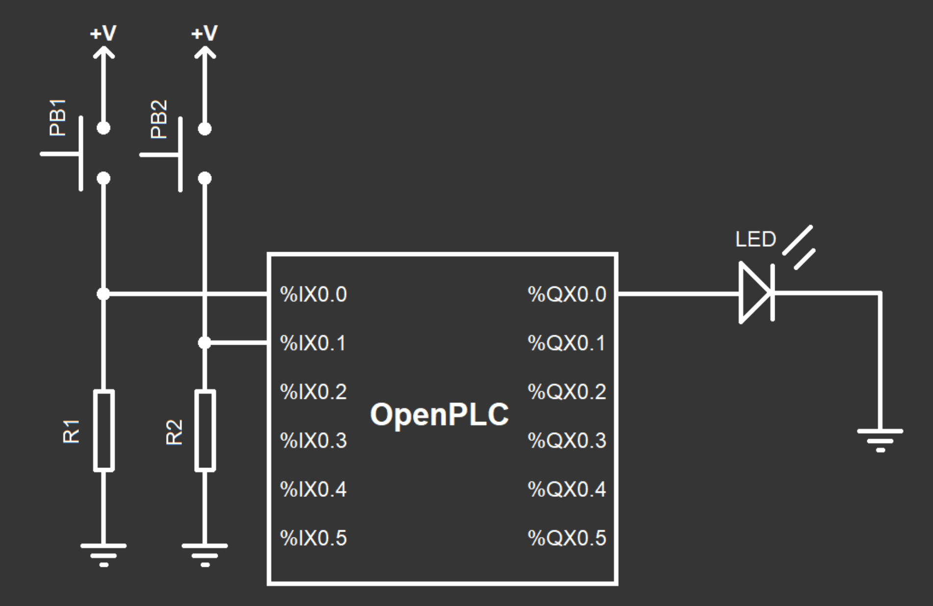
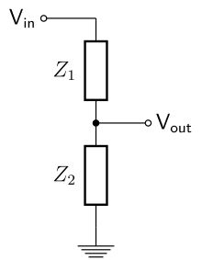
Pull Downs for Switches
When pressed there is a voltage divider with Z1 = 0, Z2 = 10K.
R1 and R2 are pull-downs.
PB1 and PB2 are switches.
When pressed (PB1 or PB2), the pin (%IX0.0 and %IX0.1) is short circuited to +V.
Since the button short circuit has 0 Ohm resistance the pin goes to +V when the button is pressed.
When not pressed, the pull-downs pull the voltage to 0V (GND).
Use a 10K Ohm resistor for R1 and R2.

Slide 14
Resistors for LEDs
Forgetting the resistor will burn the LED.
Resistors can be used to limit current flow.
Use a 1K-10K Ohm resistor.
Using larger resistors will dim the brightness of the LED (by decreasing the current).
Typical datasheet
https://www.sparkfun.com/datasheets/Components/YSL-R596CR3G4B5C-C10.pdf

Slide 15
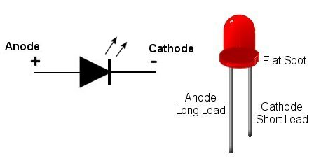
LED
Light Emitting Diode (LED)

